Slide 1

Spotify Streaming History
BY Manasi Sawant

Slide 2
🎯 Slide 2: Objectives
Problem Statement :
Spotify generates a large volume of streaming data that reveals insights into user engagement, track preferences, time-based trends, and session patterns. This project aims to extract those insights to improve recommendation algorithms, playlist curation, and user retention strategies.
Goal: Extract insights to improve recommendations, playlist duration, and user retention.

Slide 3
🎯 Objectives
Understand User Listening Preferences
Identify top artists, albums, and songs played.
Compare current year vs. previous year listening trends.
Analyze Skipping Behavior
Determine which tracks are frequently skipped.
Check if favorite songs are sometimes skipped.
Explore Listening Time Patterns
Identify peak hours and days for music streaming.
Detect habits like late-night listening or weekend bingeing.
Measure Discovery vs. Loyalty
Track how often the user explores new artists.
Understand how often familiar artists are revisited.

Slide 4
This dataset captures a complete listening history from Spotify for a specific user. It includes detailed playback metadata for each track streamed, covering both qualitative and quantitative aspects. This dataset contains 149,860 Spotify track streaming records with fields including:- Track Name, Artist, Album- Playback Duration (ms), Platform, Timestamps- Skip Fla.
📊 Data Overview
Column Name | Description
timestamp | Date and time when the track was played
track_name | Name of the song
artist_name | Artist who performed the song
album_name | Album from which the song is taken
ms_played | Duration (in milliseconds) the track
reason_start | Reason the track started playing
reason_end | Reason the track stopped
track_duration_ms | Total duration of the trac
skipped | Whether the song was skipped

Slide 5
✨ Key Features of the Dataset
1.Temporal Granularity
Timestamps allow exploration of:
Hourly paterns
Weekly cycles
Monthly/yearly trtends
2. Behavioral Tags
reason_start and reason_end give insight into user intention:
Voluntary play vs. algorithmic
Manual skip vs. natural end
3. Play Duration Metrics
ms_played helps in:
Measuring engagement per song
Inferring skipping behavior

Slide 6

SQL QUERIES

Slide 7
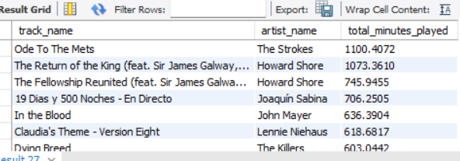
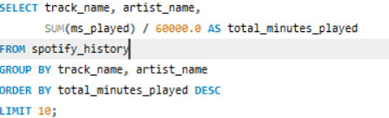
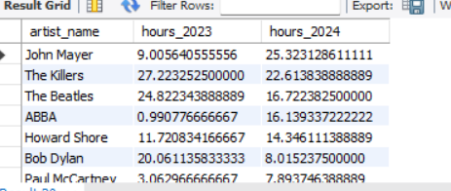
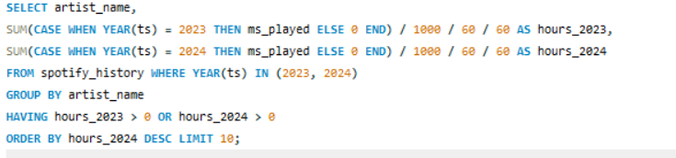
#1 which artist were most listened to this year
Output:
# 2. How does that compare to last year?
Output:

Slide 8
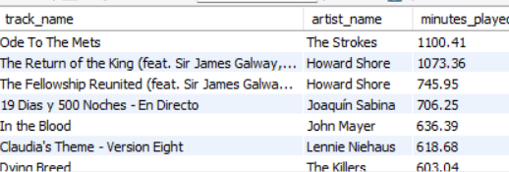
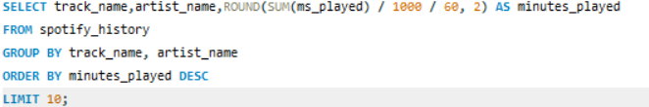
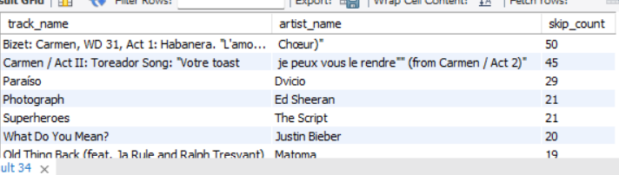
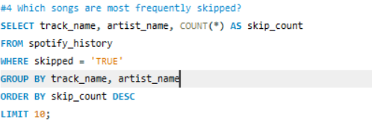
#3 what are the most played songs to overall?
OUTPUT :
#4 Which songs are most frequently skipped?
OUTPUT :

Slide 9
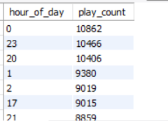
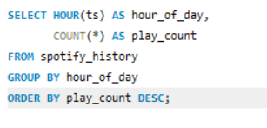
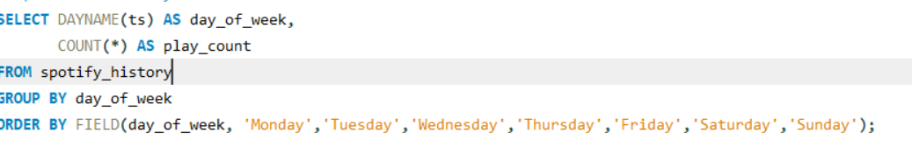
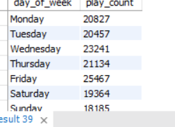
⏰ Listening Time Analysis
Most common time of day
OUTPUT:
b) Most common day of the week
OUTPUT:

Slide 10
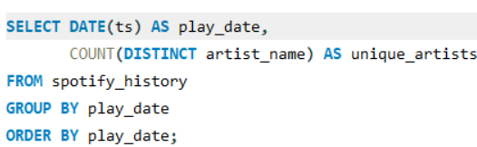
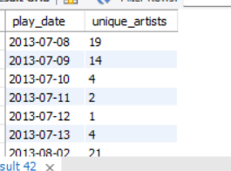
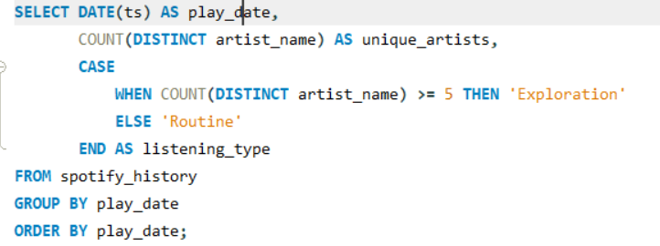
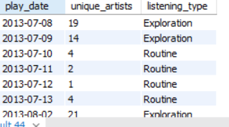
🔁 Discovery vs. Loyalty
a) How often user listens to new vs. familiar artistsFirst, get distinct artist count per day:
OUTPUT:
b) Detect days of exploration vs. routine (Using a threshold of 5 new artists/day)
OUTPUT:

Slide 11
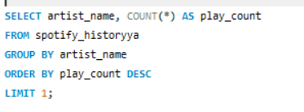

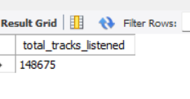

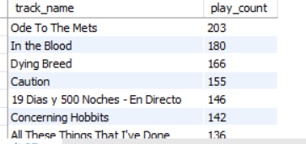
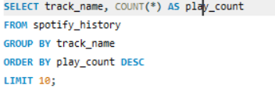
# Most played artist
OUTPUT:
#Total number of songs listened
OUTPUT:
#Top 10 most played songs
OUTPUT:

Slide 12
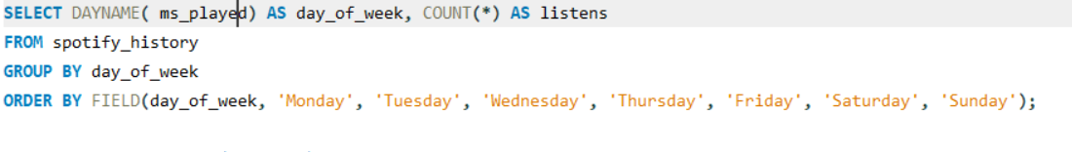
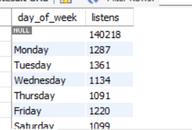


#Listening activity by day of week
OUTPUT
#Total listening time (in hours)
OUTPUT

Slide 13
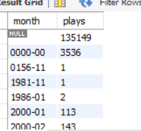
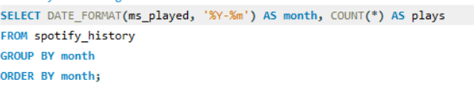
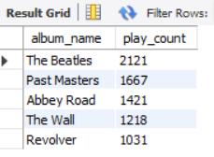
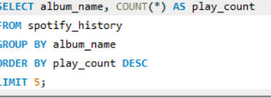
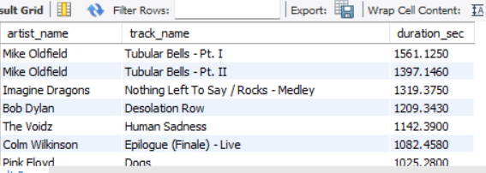
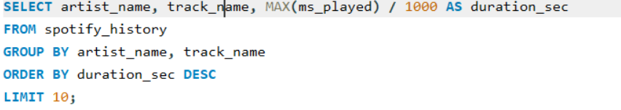
#Monthly listening trend
OUTPUT
#Top albums played
OUTPUT
#Longest track played
OUTPUT

Slide 14


